Slide 1
SISTEMAS OPERATIVOS
SO
E – M 2019

Slide 2
Memory Management
Main Memory

Slide 3
General view
Program must be brought (from disk) into memory and placed within a process for it to be run
Main memory and registers are only storage CPU can access directly
Memory unit only sees a stream of addresses + read requests, or address + data and write requests
The CPU fetches instructions from memory according to the value of the program counter PC
Register access in one CPU clock (or less)
Main memory can take many cycles, causing a stall
Cache sits between main memory and CPU registers
Protection of memory required to ensure correct operation

Slide 4
CPU Fetch and Exec Cycles
Ciclo de Interrupción
Ciclo de Fetch
Ciclo de ejecución
Interrupts Disabled
START
Fetch Next
Instruction
Execute
Instruction
Check for
Process Int
Interrupts Enabled
HALT
Operaciones Atómicas

Slide 5
A process’ address space / context
0xFFFFFFFF
OS resources
(open files, network connect.,
Sound channels, …)
CPU
General Registers
stack
(storage call returns, etc.)
SP
Memory address space
heap
(dynamic allocated mem)
Code section
(text segment)
PC
static data section
(data segment)
0x00000000

Slide 6
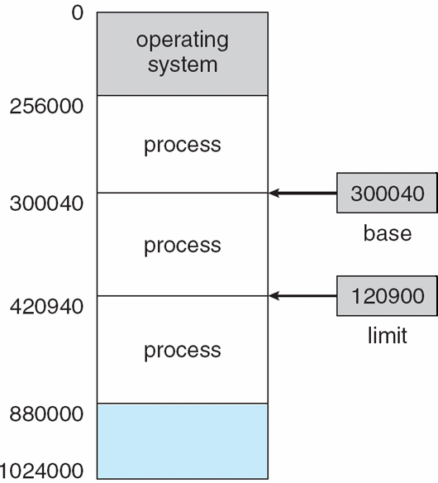
Base and Limit Registers
Memory Management Unit (MMU) : hardware unit
A pair of base and limit registers define the physical address space
CPU must check every memory access (fetch cycle) generated in user mode to be sure it is between base and limit for that user

Slide 7
Address Protection
Instruction in CPU Execution Time

Slide 8
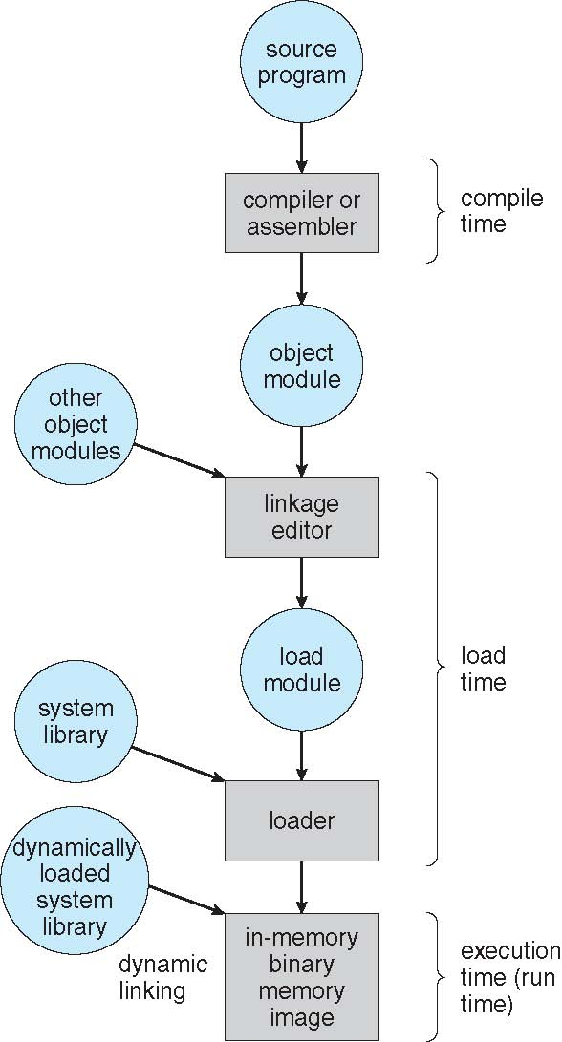
Multistep Processing of a User Program

Slide 9
Address Binding
Programs on disk, ready to be brought into memory to execute, form an input queue
Without support, must be loaded into address 0000
Inconvenient to have first user process physical address always at 0000
How can it not be?

Slide 10
Binding of Instructions and Data to Memory
Address binding of instructions and data to memory addresses can happen at three different stages
Compile time: If memory location known a priori, absolute code can be generated; must recompile code if starting location changes. If do not, then must generate a relocatable code
i.e. “14 bytes from beginning of this module”
Linker and Load time: Compiler must generate relocatable code if memory location is not known at compile time
i.e. 74014
Execution time: Binding delayed until run time if the process can be moved during its execution from one memory segment to another
Need hardware support for address maps (e.g., base and limit MMU registers)

Slide 11
Logical vs. Physical Address Space
The concept of a logical address space that is bound to a separate physical address space is central to proper memory management
Logical address – generated by the User Program; also referred to as virtual address
Physical address – address seen by the memory unit (MMU)
Logical and physical addresses are the same in compile-time and load-time address-binding schemes; logical (virtual) and physical addresses differ in execution-time address-binding scheme
Logical address space is the set of all logical addresses generated by a program
Physical address space is the set of all physical addresses generated by a program

Slide 12
Memory-Management Unit (MMU)
Hardware device that at run time maps logical or virtual to physical address
Many methods possible, covered in the rest of this chapter
To start, consider simple scheme where the value in the relocation register is added to every address generated by a user process at the time it is sent to memory
Base register now called relocation register
The user program deals with logical addresses; it never sees the real physical addresses
Execution-time binding occurs when reference is made to location in memory
Logical address bound to physical addresses

Slide 13
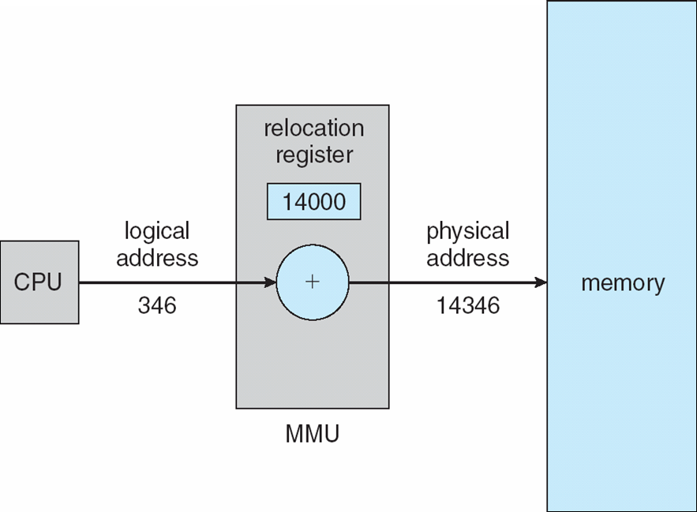
Dynamic relocation using a relocation register
The base register is now called a relocation register R
The value in the relocation register is added to every address generated by a user process at the time the address is sent to memory
Two different types of addresses:
logical addresses in the range 0 to max
physical addresses in the range R+0 to R+max for a base value R

Slide 14
Manage of Routines
Program Routines – routines in a program code
Library Routines – routines in a Library
System Library Routines – routines in a System Library
MANAGING TECHNIQUES
Static linking – system libraries and program code combined by the loader into the binary program image
Dynamic loading –saving space with program routines
Dynamic linking –linking postponed until execution time

Slide 15
Dynamic Loading for routines
Routine is not loaded until it is called
Better memory-space utilization; unused routine is never loaded
All routines kept on disk in relocatable load format
Useful when large amounts of code are needed to handle infrequently occurring cases
No special support from the operating system is required
Implemented through program design
OS can help by providing libraries to implement dynamic loading

Slide 16
Dynamic Linking
Small piece of code, stub, used to locate the appropriate memory-resident library routine
Stub replaces itself with the address of the routine, and executes the routine
Operating system checks if routine is in processes’ memory address
If not in address space, add to address space
Dynamic linking is particularly useful for libraries
System also known as shared libraries
Consider applicability to patching system libraries
Versioning may be needed

Slide 17
Swapping - 1
A process can be swapped temporarily out of memory to a backing store, and then brought back into memory for continued execution
Total physical memory space of processes can exceed physical memory
Backing store – fast disk large enough to accommodate copies of all memory images for all users; must provide direct access to these memory images
Roll out, Roll in – swapping used for priority-based scheduling algorithms; lower-priority process is swapped out so higher-priority process can be loaded and executed
Major part of swap time is transfer time; total transfer time is directly proportional to the amount of memory swapped
System maintains a Ready Queue of ready-to-run processes which have memory images on disk

Slide 18
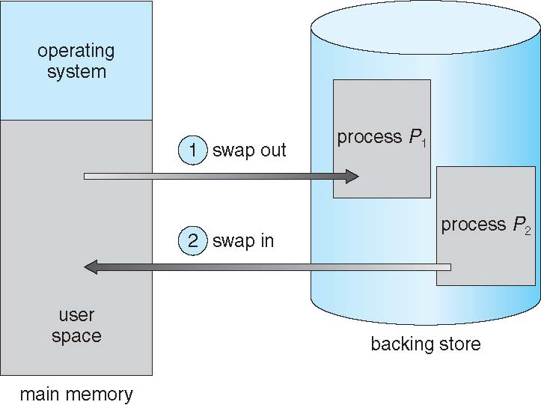
Schematic View of Swapping

Slide 19
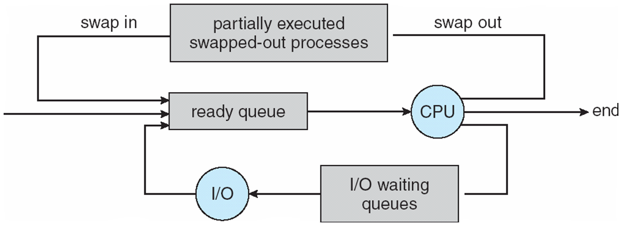
Medium Term Scheduling Aggregation
Could be aggregated and works control multiprogramming degree
Removes processes from memory and storage them up in disk (reduce the grade), and bring them back from disk to memory (increase the grade) to continue the execution: swapping

Slide 20
Swapping - 2
Modified versions of swapping are found on many systems
Swapping normally disabled
Started if more than threshold amount of memory allocated
Disabled again, once memory demand reduced below threshold
Does the swapped out process need to swap back in to same physical addresses?
Depends on address binding method
Plus consider pending I/O to / from process memory space

Slide 21
Context Switch Time including Swapping - 3
Other constraints as well on swapping
Pending I/O – can’t swap out as I/O would occur to wrong process
Or always transfer I/O to kernel space, then to I/O device
Known as double buffering, adds overhead
Standard swapping not used in modern operating systems
But modified version common
Swap only when free memory extremely low

Slide 22
Context Switch Time including Swapping - 4
If next processes to be put on CPU is not in memory, need to swap out a process and swap in target process
Context switch time can then be very high
100MB process swapping to hard disk with transfer rate of 50MB/sec
Swap out time of 2000 ms (2 seconds)
Plus swap in of same sized process
Total context switch swapping component time of 4000ms (4 seconds)
Can decrease if reduce size of memory swapped – by knowing how much memory really being used
System calls to inform OS of memory use via request_memory() and release_memory()

Slide 23
Swapping on Mobile Systems
Not typically supported
Flash memory based
Small amount of space
Limited number of write cycles
Poor throughput between flash memory and CPU, on mobile platform
Instead, use other methods to free memory if low
iOS asks apps to voluntarily relinquish allocated memory
Read-only data thrown out and reloaded from flash if needed
Failure to free can result in termination
Android terminates apps if low free memory, but first writes application state to flash for fast restart
Both OSes support paging

Slide 24
References
Presentación de Ramon Ríos.
Capítulos: Operating System Concepts; Silberschatz, Galvin, Gagne.
23-abr-2019

